Slide 1
Introduction to Deep Learning
Prof. Junetae Kim
lyjune0070@gmil.com

Slide 2
Chapter 0
Lecture Overview and Table of Contents

Slide 3
Table of Contents
Overview of Deep Learning
Fundamental Theories and Concepts
Core Elements of Deep Learning
Further Details for Stable Deep Learning Training
Exercise

Slide 4
Learning Objectives
Understand the basic terms and concepts of deep learning
Comprehend the principles of linear regression, logistic regression, and neural networks
Grasp core elements such as MLE, cost functions, and regularization
Explore techniques to prevent overfitting and workflow for designing deep learning models

Slide 5
Chapter 1
Overview of Deep Learning

Slide 6
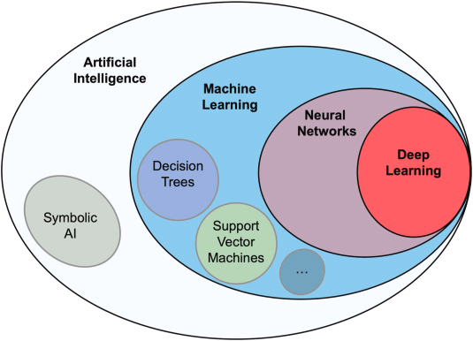
Relationship Between AI, ML, and DL
Artificial Intelligence (AI): Technologies that mimic human intelligence
Machine Learning (ML): Statistical methods to learn from data
Deep Learning (DL): A subset of ML based on deep neural networks
https://www.sciencedirect.com/science/article/pii/S109671762030166X

Slide 7
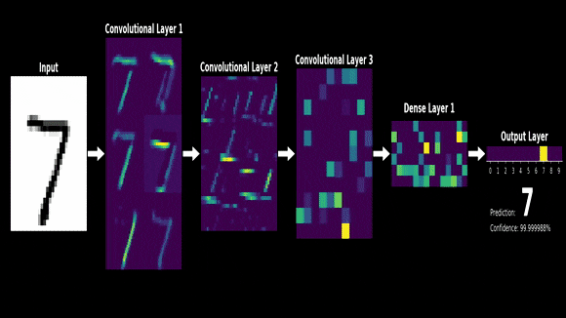
What is Deep Learning?
A subset of machine learning, which is essentially a neural network with three or more layers.
These neural networks attempt to simulate the behavior of the human brain, allowing it to “learn” from large amounts of data.
https://gfycat.com/contentdarlingcub-3brown1blue-mathematics-three-one
https://www.ibm.com/cloud/learn/deep-learning

Slide 8
Key Features of Deep Learning
Depth: A subset of machine learning, essentially a neural network with three or more layers.
Non-linearity: Learning complex relationships with activation functions
Representation: Automatic feature extraction
Scalability: Large-scale data and hardware (GPUs/TPUs) utilization
Breakthrough Performance: Significant improvements in vision, speech, and natural language processing
Flexibility: Diverse designs (an infinite variety of model structures)

Slide 9
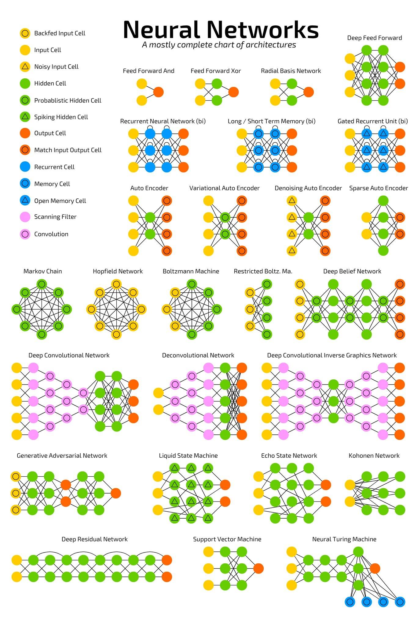
Types of Deep Learning Algorithms

Slide 10
Types of Deep Learning Algorithms

Slide 11
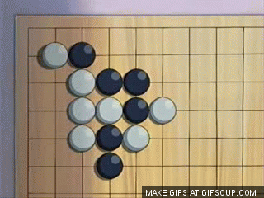
Example of Deep Learning Application in Practice
Go game
An abstract strategy board game for two players in which the aim is to surround more territory than the opponent.

Slide 12
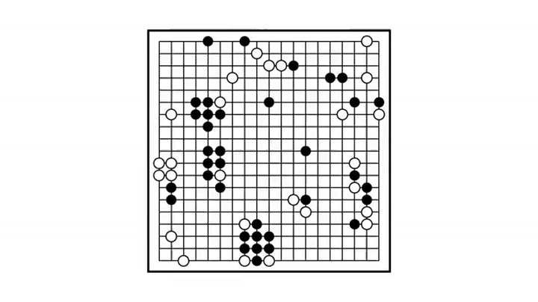
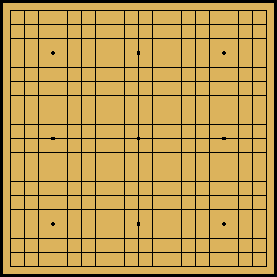
Example of Deep Learning Application in Practice
Alphago

Slide 13
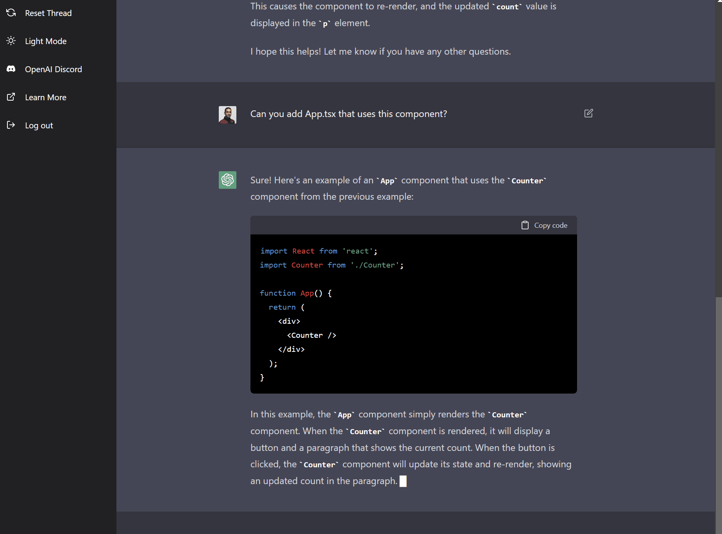
Example of Deep Learning Application in Practice
CHAT GPT for code generation

Slide 14
Other Applications
Computer Vision
Image Classification: Examples like MNIST and ImageNet
Object Detection: Autonomous vehicles, security systems
Medical Imaging Analysis: Automatic cancer detection
Natural Language Processing (NLP)
Machine Translation: Google Translate, Papago, etc.
Sentiment Analysis: Extracting sentiment from social media or reviews
Chatbots: Automating customer support and services
Recommendation Systems
Personalized Content Recommendations: YouTube, Netflix, Spotify
E-commerce: Product recommendations (e.g., Amazon, Coupang)
Techniques: Collaborative Filtering, Content-Based Filtering

Slide 15
Workflow of Deep Learning
Steps: Data Collection → Preprocessing → Model Design → Training → Evaluation → Deployment
Key Concepts: Backpropagation, cost functions, activation functions, regularization

Slide 16
Chapter 2
Fundamental Theories and Concepts

Slide 17
Background of Linear Regression
Objective: Estimate the linear relationship between input (independent variables) x and output (dependent variable) y
Example: Predicting house prices based on size
Y = house
X = size

Slide 18
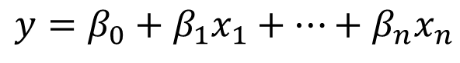
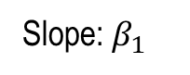
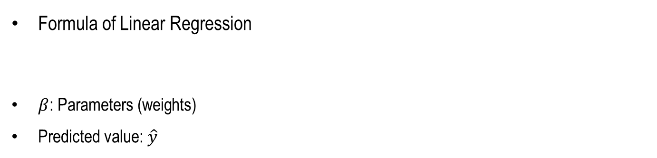
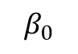
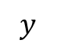
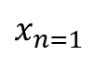
Background of Linear Regression
Formula of Linear Regression
$β$: Parameters (weights)
Predicted value: $\hat{y}$
$$y=β_{0}+β_{1}x_{1}+…+β_{n}x_{n}$$
$$y$$
Slope: $β_{1}$
$$β_{0}$$
$$x_{n=1}$$

Slide 19
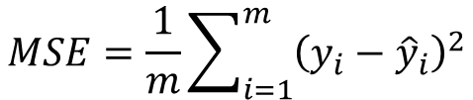
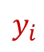
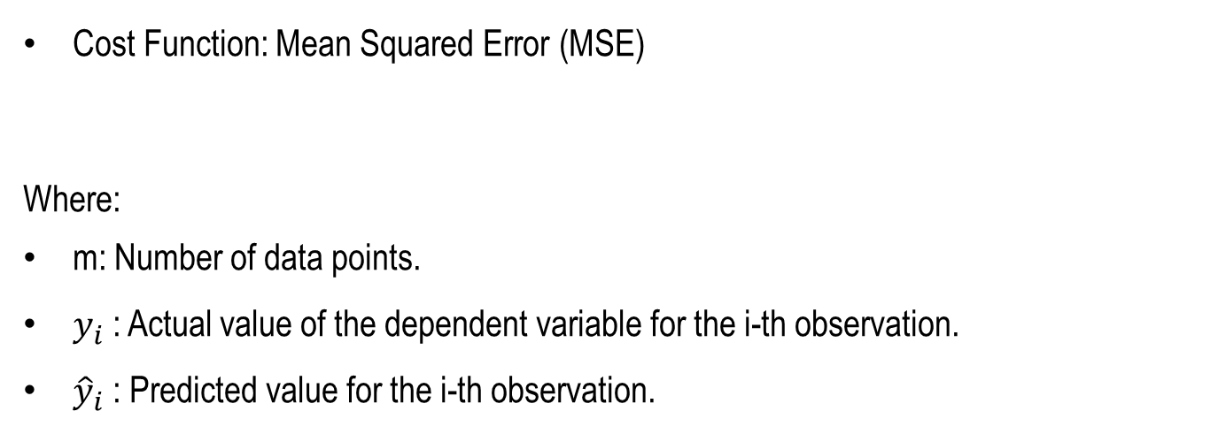
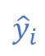
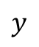
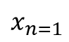
Background of Linear Regression
$$y$$
Cost Function: Mean Squared Error (MSE)
Where:
m: Number of data points.
$y_{i}$​: Actual value of the dependent variable for the i-th observation.
${\hat{y}}_{i}$​: Predicted value for the i-th observation.
$$MSE=\frac{1}{m}\sum_{i=1}^{m}{{\left(y_{i}−{\hat{y}}_{i}\right)}^{2}}$$
$${\hat{y}}_{i}$$
$$y_{i}$$
$$x_{n=1}$$
Key Points:
Lower MSE indicates better model performance.
Penalizes large prediction errors more heavily due to the squaring term.

Slide 20
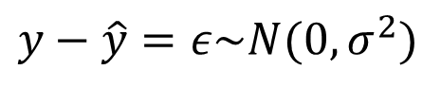
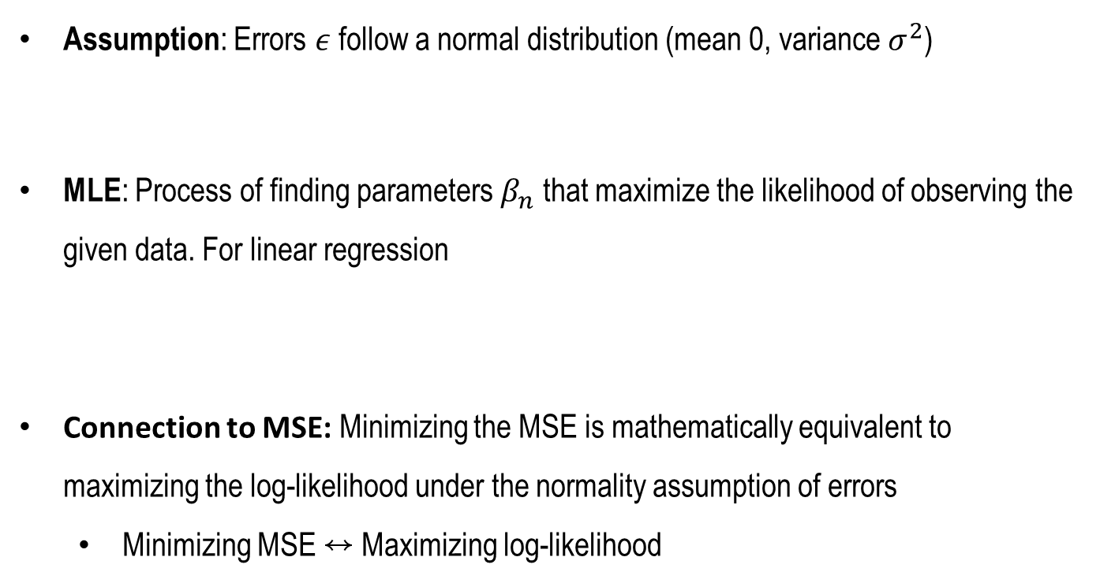

Relationship Between MSE and MLE
Maximum Likelihood Estimation (MLE)
Assumption: Errors $ε$ follow a normal distribution (mean 0, variance $σ^{2}$)
MLE: Process of finding parameters $β_{n}$that maximize the likelihood of observing the given data. For linear regression
Connection to MSE: Minimizing the MSE is mathematically equivalent to maximizing the log-likelihood under the normality assumption of errors
Minimizing MSE ↔ Maximizing log-likelihood
$$y−\hat{y}=ε\sim N(0,σ^{2})$$
$$L\left(B\right)=\prod_{i=1}^{m}{\frac{1}{\sqrt{2πσ^{2}}}e^{−\frac{{\left(y_{i}−{\hat{y}}_{i}\right)}^{2}}{2σ^{2}}}}$$

Slide 21
Background of Logistic Regression
Objective: Logistic regression is designed to solve binary classification problems, where the target variable (y) takes values of either 0 or 1.
Example: Predict whether a patient has a specific disease (1) or not (0)
Y
Linear model
1
p
Logistic regression model
0
X

Slide 22
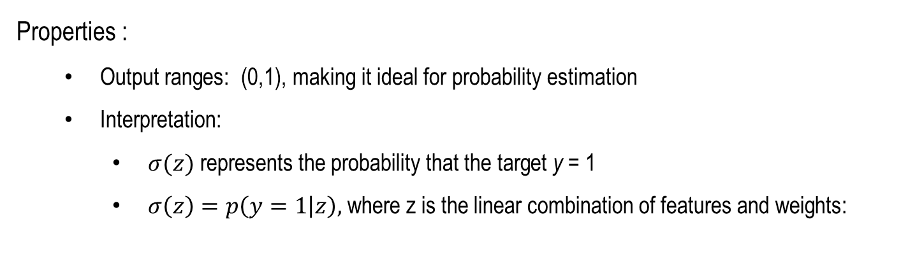
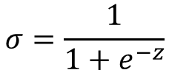
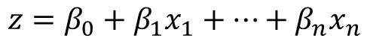
Sigmoid Function and Probabilistic Interpretation
The sigmoid function : It maps any real-valued input (z) to a value in the range (0, 1).
$$σ=\frac{1}{1+e^{−z}}$$
Properties :
Output ranges: (0,1), making it ideal for probability estimation
Interpretation:
$σ(z)$ represents the probability that the target y = 1
$σ\left(z\right)=p\left(y=1 | z\right),$ where z is the linear combination of features and weights:
$$z=β_{0}+β_{1}x_{1}+…+β_{n}x_{n}$$

Slide 23
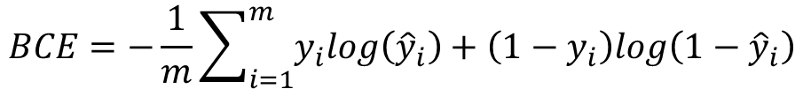
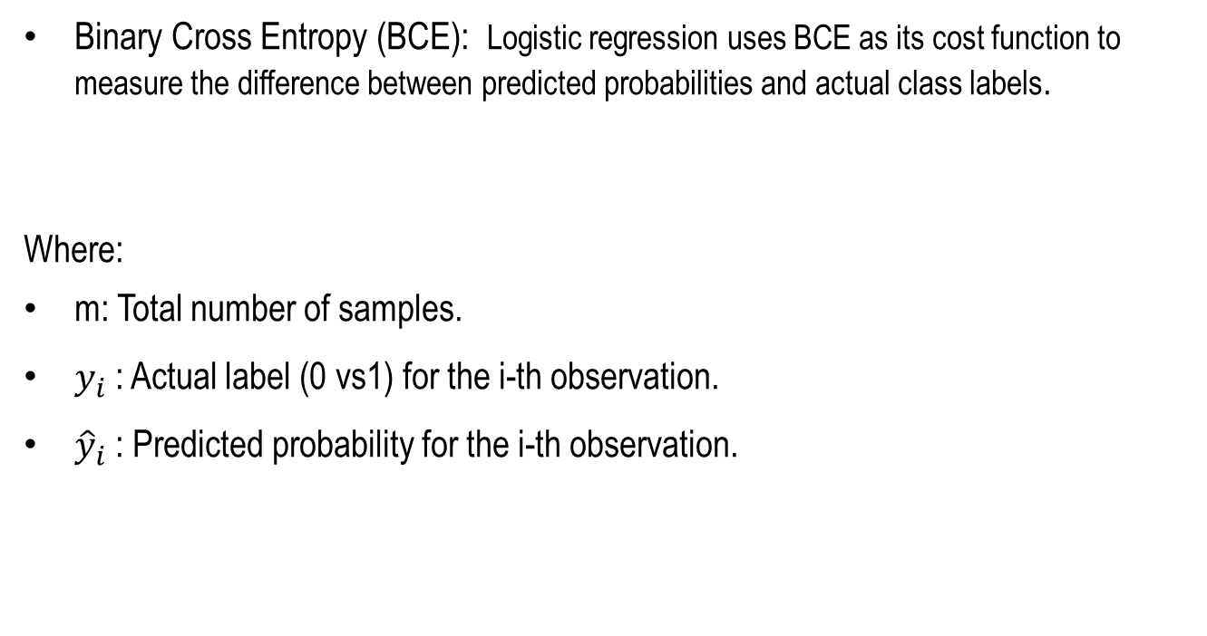
Cost Function in Logistic Regression
Binary Cross Entropy (BCE): Logistic regression uses BCE as its cost function to measure the difference between predicted probabilities and actual class labels.
Where:
m: Total number of samples.
$y_{i}$​: Actual label (0 vs1) for the i-th observation.
${\hat{y}}_{i}$​: Predicted probability for the i-th observation.
$$BCE=−\frac{1}{m}\sum_{i=1}^{m}{y_{i}log\left({\hat{y}}_{i}\right)+\left(1−y_{i}\right)log\left(1−{\hat{y}}_{i}\right)}$$
Key Points:
BCE penalizes incorrect predictions based on their confidence levels.
It ensures the model learns to output probabilities that align with actual class labels.

Slide 24
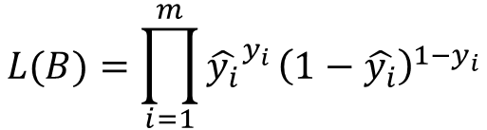
Relationship Between BCE and MLE
Perspective: Logistic regression is a probabilistic model, finding the set of parameters 𝛽 that maximizes the likelihood of the observed labels given the features
Likelihood function:
Connection to BCE: Maximizing the log-likelihood is equivalent to minimizing the BCE. This connects logistic regression to a probabilistic framework
$$L(B)=\prod_{i=1}^{m}{{\hat{y_{i}}}^{y_{i}}}{\left(1−\hat{y_{i}}\right)}^{1−y_{i}}$$

Slide 25
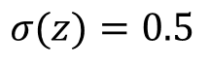
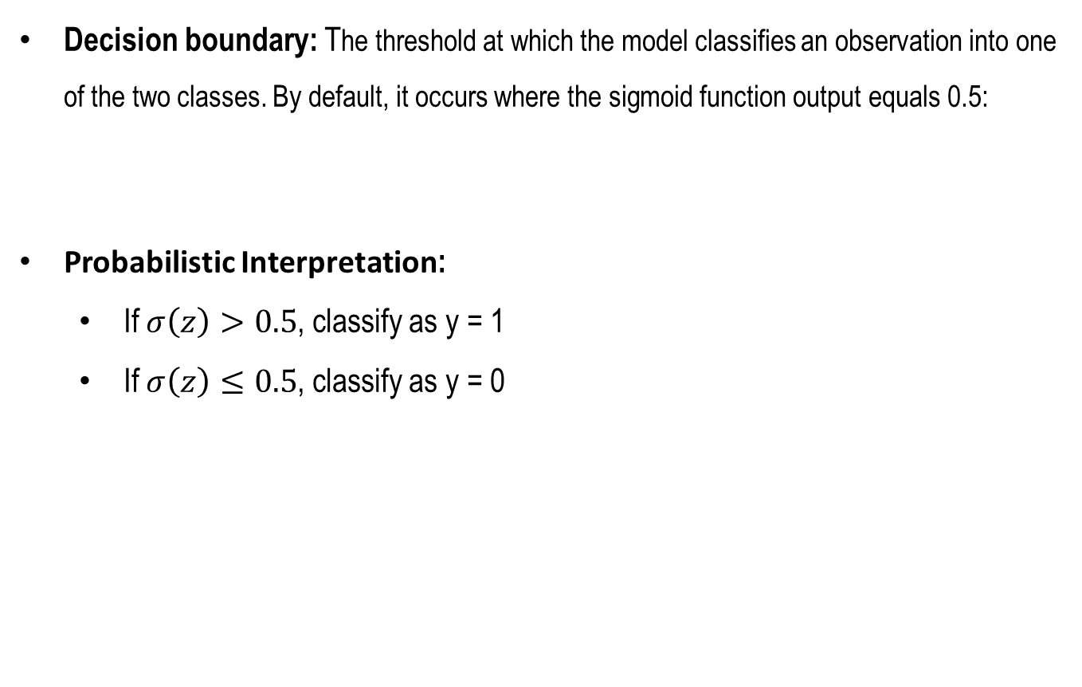
Decision Boundary in Logistic Regression
Decision boundary: The threshold at which the model classifies an observation into one of the two classes. By default, it occurs where the sigmoid function output equals 0.5:
Probabilistic Interpretation:
If $σ\left(z\right)>0.5$, classify as y = 1
If $σ\left(z\right)≤0.5$, classify as y = 0
$$σ(z)=0.5$$

Slide 26
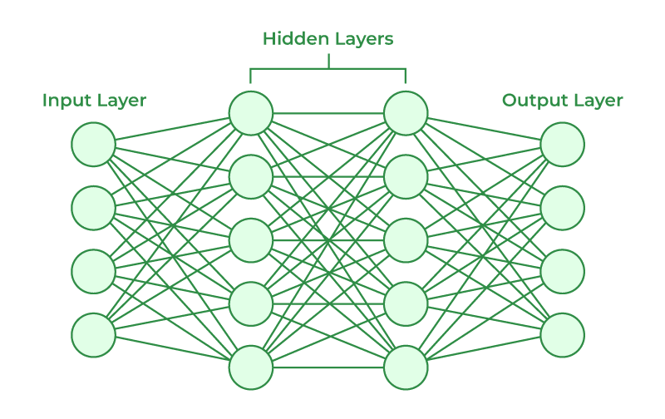
Neural Networks (NNs): Basics
Inspiration : Neural networks are modeled after the behavior of biological neurons in the human brain, mimicking their ability to process and learn from inputs
Structure:
Neural networks consist of:
Input Layer: Takes in raw data as input features.
Hidden Layers: Perform computations and extract patterns from the data using neurons.
Output Layer: Produces the final prediction or classification result.

Slide 27
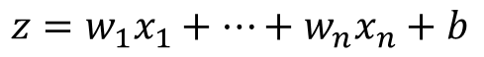
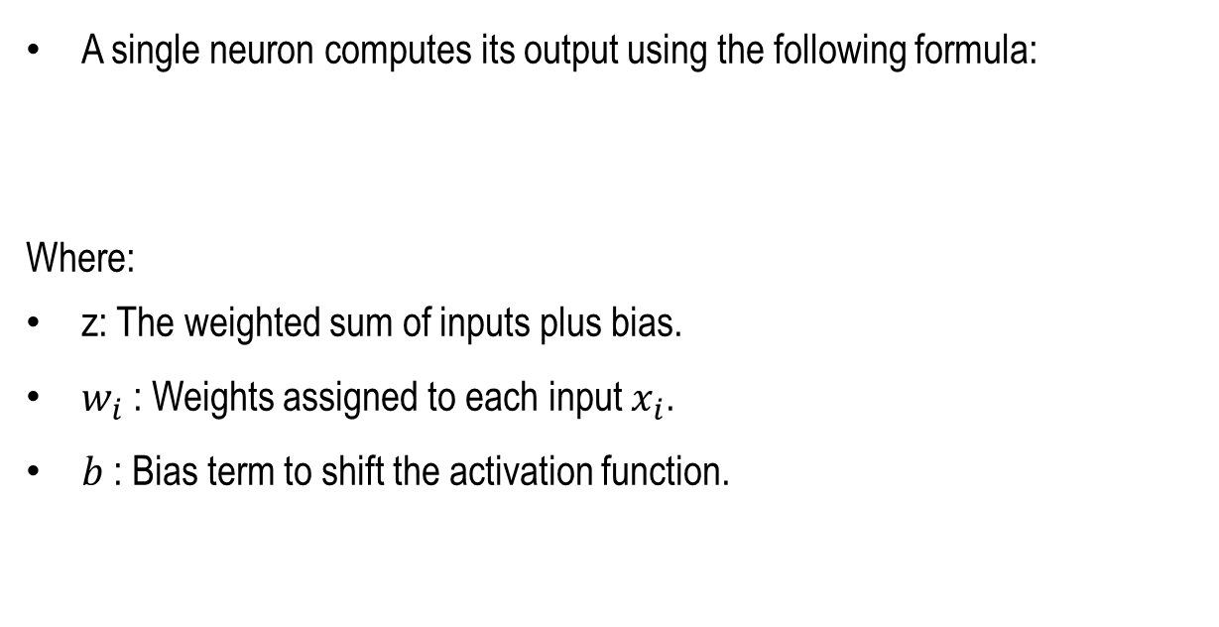
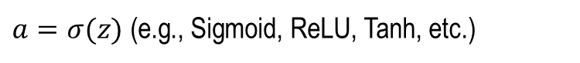
Computation of a Single Neuron
A single neuron computes its output using the following formula:
Where:
z: The weighted sum of inputs plus bias.
$w_{i}$​: Weights assigned to each input $x_{i}$.
$b$​: Bias term to shift the activation function.
$$z=w_{1}x_{1}+…+w_{n}x_{n}+b$$
$a=σ(z)$ (e.g., Sigmoid, ReLU, Tanh, etc.)

Slide 28
Parameters in Neural Networks
Definition:
Parameters include weights (w) and biases (b), which are learned during training to minimize the error.
Complexity and Challenges:
As the network deepens (more layers) or widens (more neurons), the number of parameters increases significantly.
Large numbers of parameters increase the risk of overfitting, where the model performs well on training data but poorly on unseen data.

Slide 29
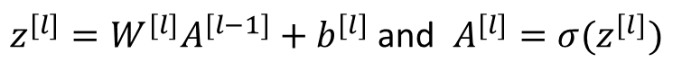
Feedforward (Forward Propagation)
Mechanism: In feedforward propagation, inputs are passed sequentially through the layers of the neural network, and each layer computes:
Where l denotes the layer index, A represents activations, W weights, and b biases
Purpose: To calculate the final output of the network and generate predictions
$z^{[l]}=W^{[l]}A^{[l−1]}+b^{[l]}$ and $A^{[l]}=σ(z^{[l]})$

Slide 30
Backpropagation
Definition: Backpropagation is an optimization algorithm that updates the parameters (w, b) of the network using the error at the output.
Process:
Gradients of the cost function are calculated with respect to the parameters using differentiation.
These gradients measure how much each parameter contributes to the error.
Significance: Backpropagation ensures the network learns effectively by adjusting weights and biases in the direction that minimizes the error.

Slide 31
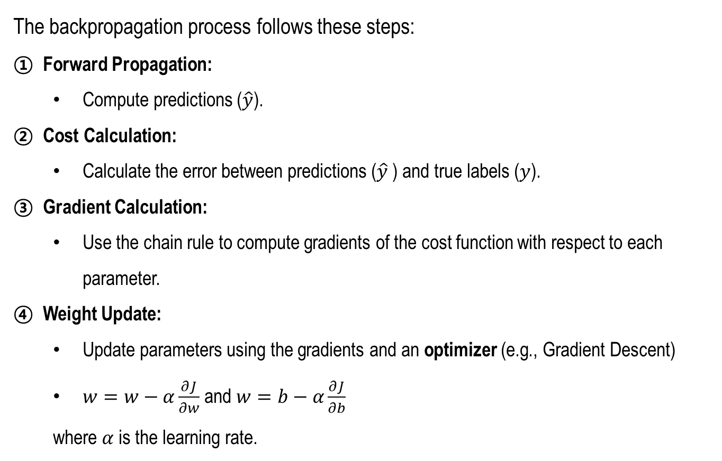
Concept of Backpropagation
The backpropagation process follows these steps:
Forward Propagation:
Compute predictions ($\hat{y}$).
Cost Calculation:
Calculate the error between predictions ($\hat{y}$​) and true labels ($y$).
Gradient Calculation:
Use the chain rule to compute gradients of the cost function with respect to each parameter.
Weight Update:
Update parameters using the gradients and an optimizer (e.g., Gradient Descent)
$w=w−α\frac{∂J}{∂w}$ and $w=b−α\frac{∂J}{∂b}$
where $α$is the learning rate.

Slide 32
Chapter 3
Core Elements of Deep Learning

Slide 33
What Are Activation Functions?
Purpose: Activation functions introduce non-linearity into neural networks, enabling them to learn complex patterns and relationships.
Types of Activation Functions:
Sigmoid: Maps values to a range of (0, 1).
Tanh: Maps values to a range of (-1, 1).
ReLU (Rectified Linear Unit): Outputs max⁡(0,x).
Leaky ReLU: Similar to ReLU but allows small negative outputs

Slide 34
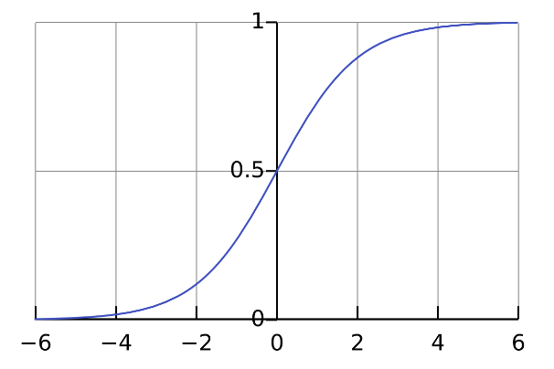
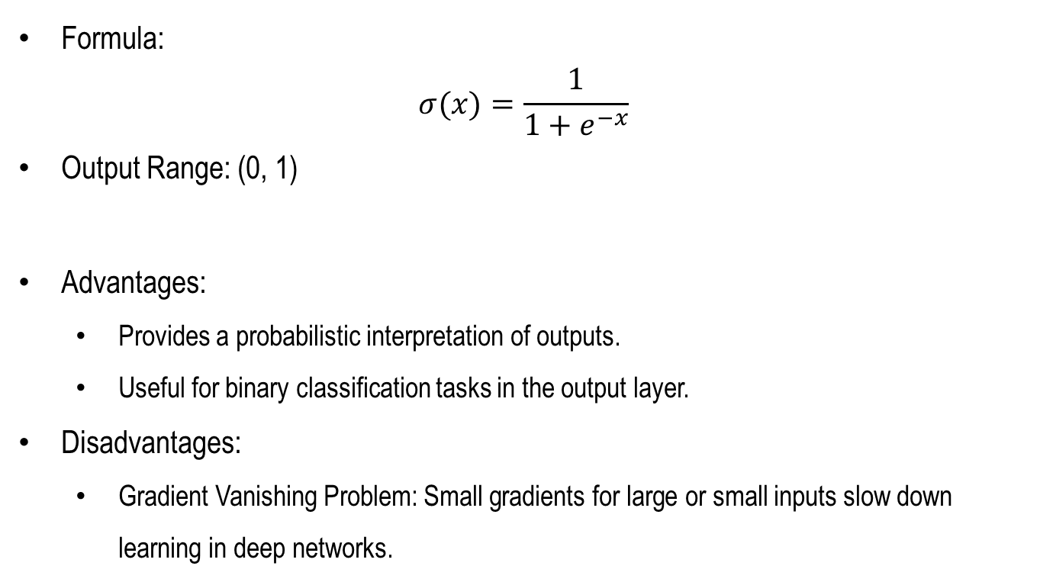
Sigmoid Function
Formula:
$$σ(x)=\frac{1}{1+e^{−x}}$$
Output Range: (0, 1)
Advantages:
Provides a probabilistic interpretation of outputs.
Useful for binary classification tasks in the output layer.
Disadvantages:
Gradient Vanishing Problem: Small gradients for large or small inputs slow down learning in deep networks.

Slide 35
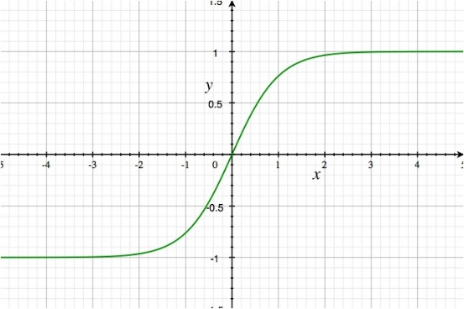
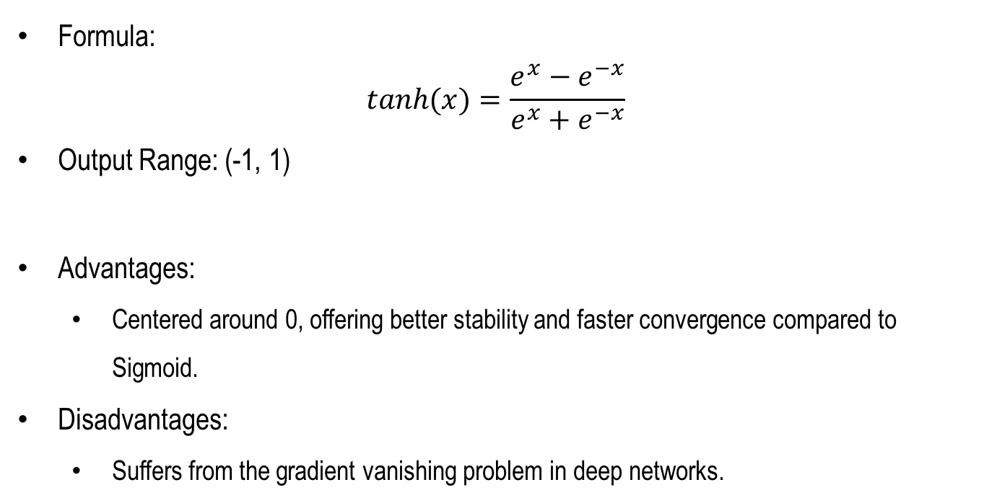
Tanh Function (Hyperbolic tangent)
Formula:
$$tanh(x)=\frac{e^{x}−e^{−x}}{e^{x}+e^{−x}}$$
Output Range: (-1, 1)
Advantages:
Centered around 0, offering better stability and faster convergence compared to Sigmoid.
Disadvantages:
Suffers from the gradient vanishing problem in deep networks.

Slide 36

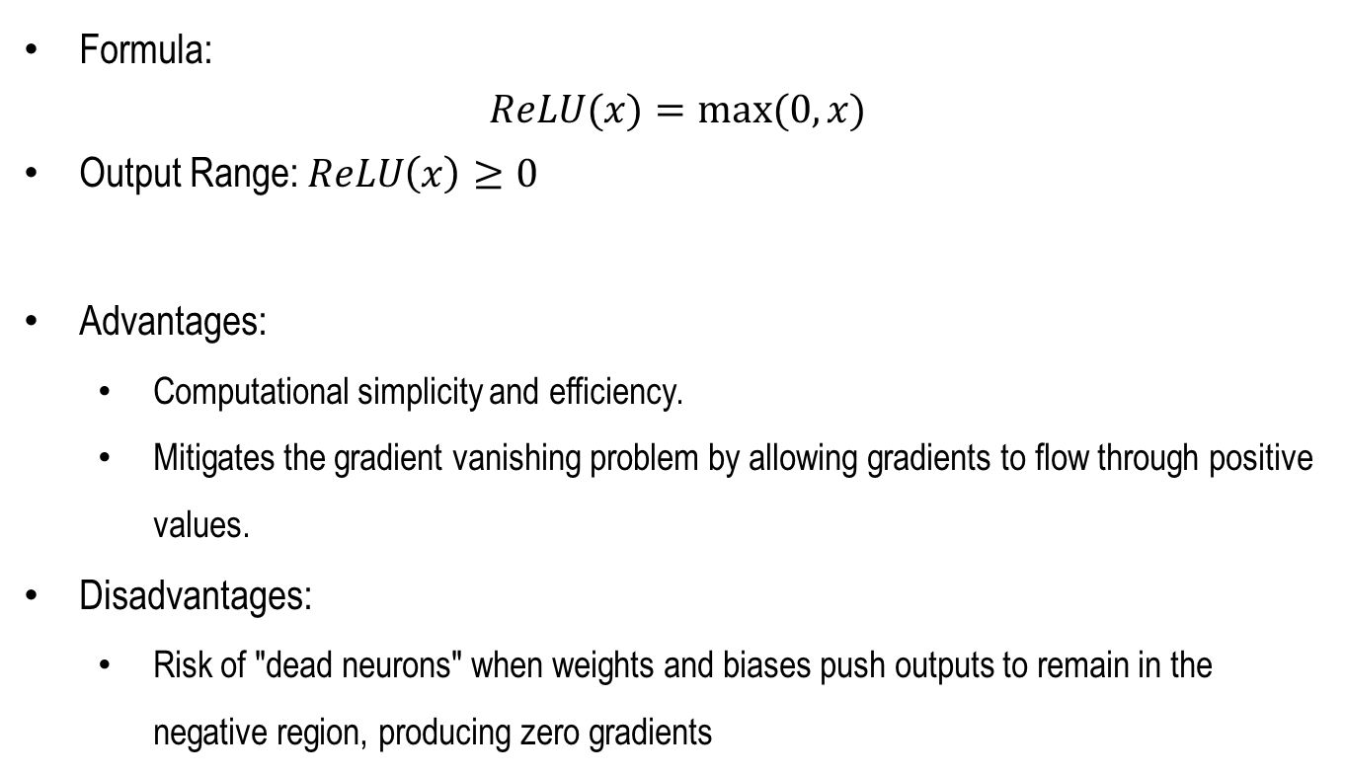
ReLU (Rectified Linear Unit) Function
Formula:
$$ReLU(x)=max⁡(0,x)$$
Output Range: $ReLU\left(x\right)≥0$
Advantages:
Computational simplicity and efficiency.
Mitigates the gradient vanishing problem by allowing gradients to flow through positive values.
Disadvantages:
Risk of "dead neurons" when weights and biases push outputs to remain in the negative region, producing zero gradients

Slide 37
Choosing Activation Functions
Output Layer:
For binary classification: Use Sigmoid.
For multi-class classification: Use Softmax.
Hidden Layers:
ReLU is the most commonly used activation function due to its efficiency and performance.
Smaller Models:
Tanh or Sigmoid may still be used in some cases for smaller networks.

Slide 38

Why Regularization is Needed
Overfitting Problem:
The model achieves high accuracy on training data but performs poorly on new, unseen data.

Slide 39
Causes of Overfitting
Excessive Model Complexity: Too many parameters relative to the amount of training data.
Insufficient Training Data: Limited or imbalanced datasets make it hard for the model to generalize.
Over-adaptation to Specific Patterns: The model learns noise or anomalies in the training data.

Slide 40
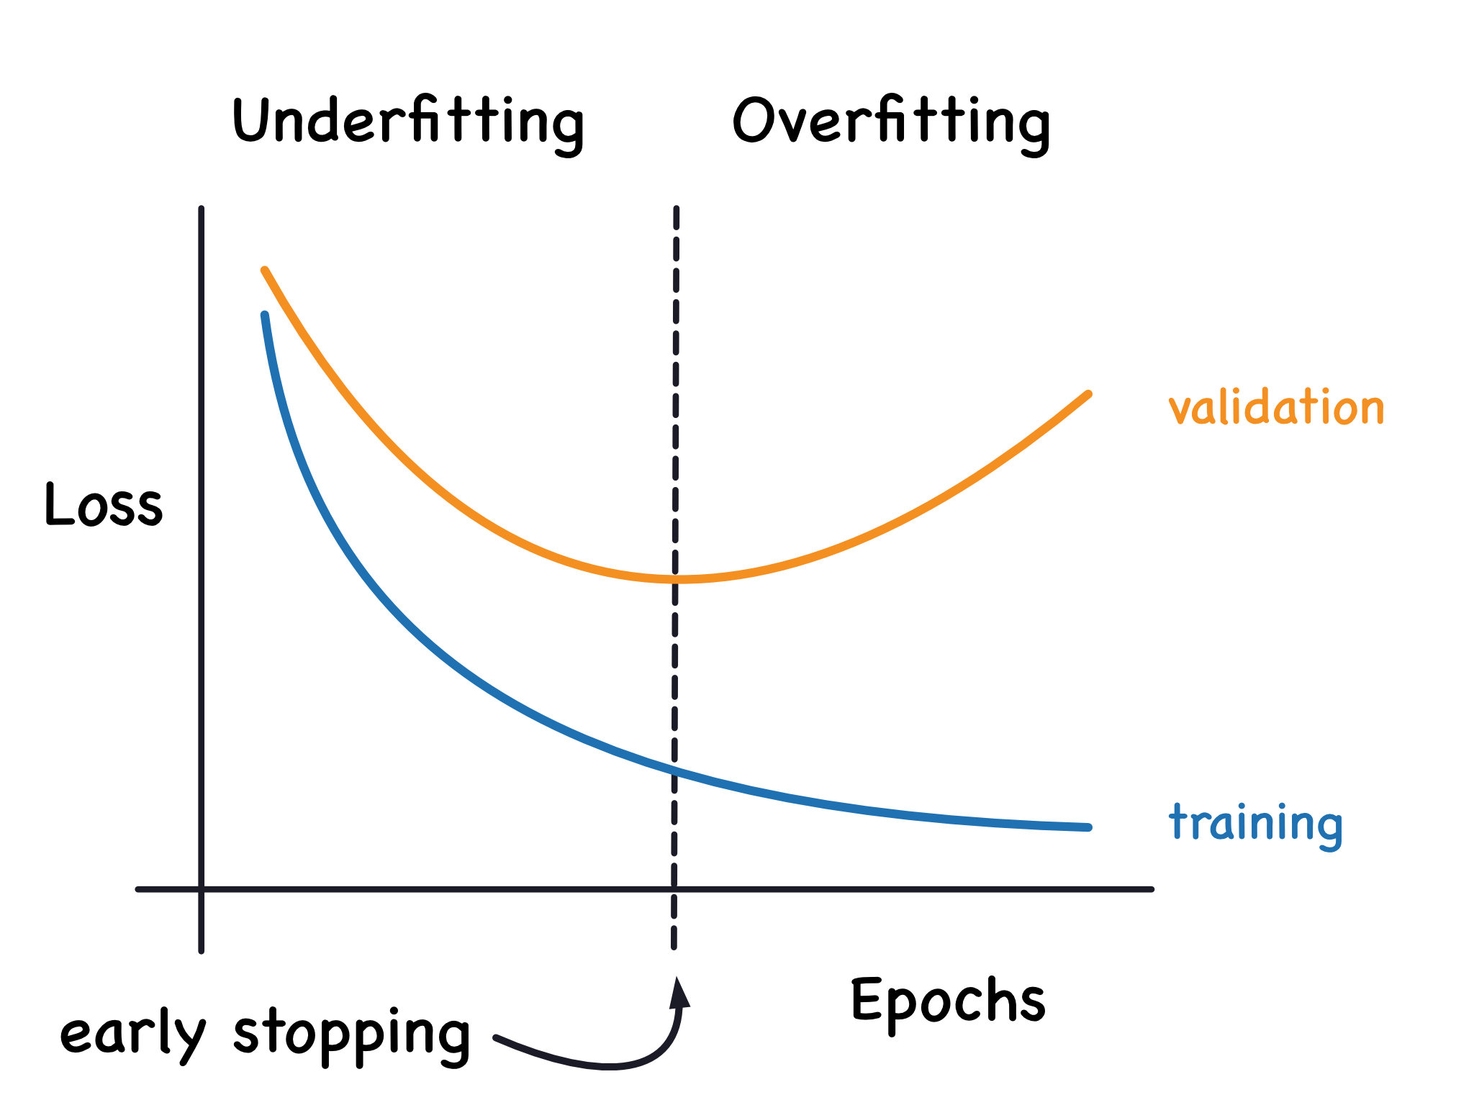
Identifying and Preventing Overfitting
Identifying Overfitting:
Training Loss: Continues to decrease.
Validation Loss: Starts to increase after a certain point.
Solution:
Regularization helps control model complexity by constraining parameter values, preventing overfitting.

Slide 41
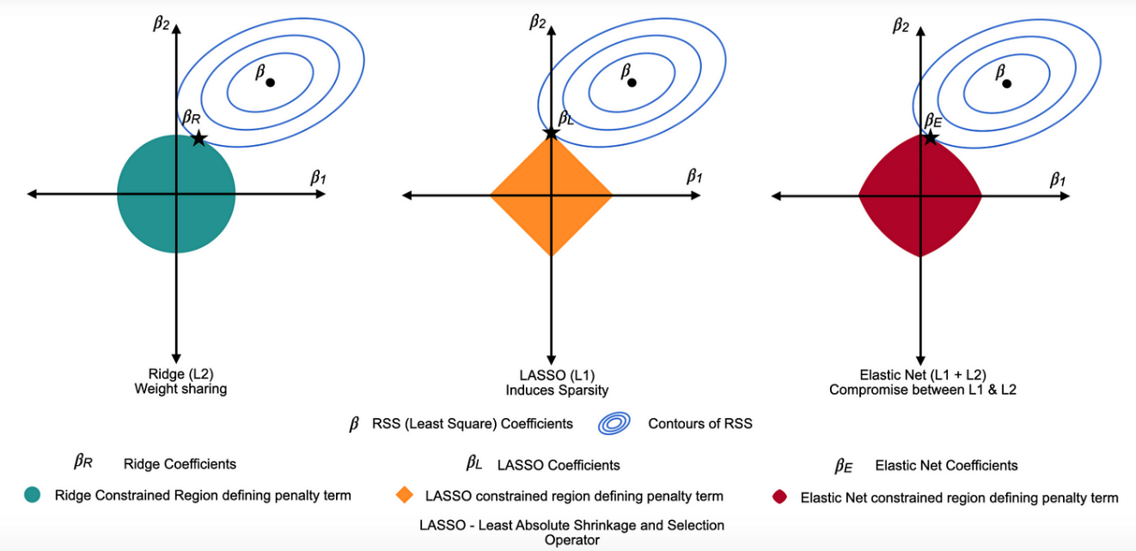

L1 Regularization (Lasso)
Cost Function:
Key Feature:
Drives some weights to become exactly zero, effectively performing feature selection and promoting sparsity
$$cost=Loss+λ\sum{\left|w_{i}\right|}$$

Slide 42

L2 Regularization (Ridge)
Cost Function:
Key Feature:
Penalizes large weights without reducing them to zero.
Produces smooth weight distributions, improving generalization
$$cost=Loss+λ\sum{{\left(w^{i}\right)}^{2}}$$

Slide 43
L1 vs. L2 Regularization
L1 Regularization:
Promotes sparsity by driving some weights to zero.
Useful for feature selection.
L2 Regularization:
Regularizes all weights by penalizing large values.
Results in smoother and more stable models.

Slide 44
Chapter 4
Further Details for Stable Deep Learning Training

Slide 45
Further Regularization Techniques
Regularization Techniques:
L1 and L2 Regularization: Penalize large parameter values to reduce complexity (already explained in Chapter 3).
These methods are widely used in diverse statistical and machine learning models
Dropout: Randomly drops neurons during training to prevent over-dependency.
Data Augmentation: Expands the dataset size through transformations.
Early Stopping: Halts training when validation loss no longer improves.

Slide 46
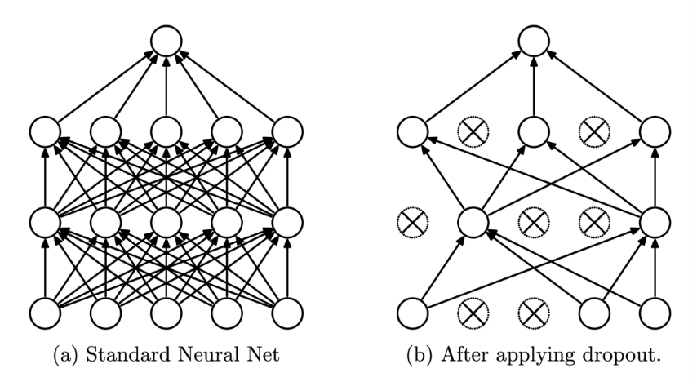
Dropout
Definition:
Dropout randomly deactivates a fraction of neurons during each training iteration.
Effect on Model:
Encourages the network to learn robust features rather than co-adapted patterns.
Reduces the risk of overfitting.
Implementation:
Commonly used in hidden layers with a specified dropout rate (e.g., 20-50%).
Disabled during inference to utilize the full network capacity.

Slide 47
Data Augmentation
Definition:
Data augmentation artificially increases the size and diversity of the dataset by applying transformations.
Examples:
Images:
Rotation, cropping, flipping, noise addition, color adjustments.
Text:
Synonym replacement, back-translation, random word insertions.
Benefits:
Reduces overfitting by exposing the model to diverse patterns.
Particularly useful for small datasets.

Slide 48
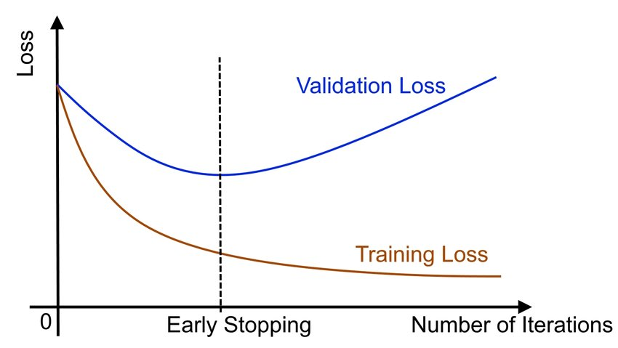
Early Stopping
Definition:
Early stopping halts training when the validation performance (loss or accuracy) no longer improves.
Advantages:
Prevents overfitting caused by excessive training.
Saves computational resources by avoiding unnecessary epochs.
Best Practices:
Monitor the validation metric and stop after a patience period (e.g., 5 epochs without improvement).

Slide 49
Workflow for Designing Deep Learning Models
Data Preparation:
Gather and preprocess data, split into training, validation, and test sets.
Model Design:
Define architecture, activation functions, and regularization techniques.
Training:
Use optimizers and loss functions to train the model iteratively.
Evaluation:
Measure performance on unseen data using appropriate metrics.
Deployment:
Integrate the model into a production environment with monitoring and feedback mechanisms.

Slide 50
Data Preparation
Steps:
Collection:
Use public datasets (e.g., ImageNet, UCI), internal data, or etc.
Preprocessing:
Handle missing values, normalize/scaling features, and encode labels.
Splitting:
Typical split: 70% training, 15% validation, 15% test.

Slide 51
Model Design
Key Considerations:
Structure:
Define input layers, hidden layers, neurons, and activation functions based on problem complexity.
Hyperparameters:
Tune learning rate, batch size, and number of epochs for optimal training.
Regularization:
Integrate techniques like Dropout, Batch Normalization, or L1/L2 regularization to reduce overfitting.

Slide 52
Training
Core Steps in Training:
Forward propagation: Compute predictions.
Loss calculation: Measure the difference between predictions and true values.
Backpropagation: Update weights using gradients.
Essential Components:
Loss Functions:
MSE for regression, Binary Cross-Entropy for binary classification.
Optimizers:
Modern optimizers like Adam or SGD are frequently used.

Slide 53
Evaluation
Key Metrics:
For Regression:
Mean Squared Error (MSE), Mean Absolute Error (MAE), R².
For Classification:
Accuracy, Precision, Recall, F1-score, Area Under Curve (AUC).
Visualization Tools:
Confusion Matrix: Detailed breakdown of classification results.
ROC Curve and AUC: Visualize and evaluate binary classification performance

Slide 54
Hyperparameter Tuning
Methods:
Grid Search: Systematically tests all combinations of predefined parameters.
Random Search: Samples random combinations of parameters for faster exploration.
Best Practices:
Use cross-validation to validate results.
Combine hyperparameter tuning with regularization and early stopping.

Slide 55
Chapter 5
Exercise

Slide 56
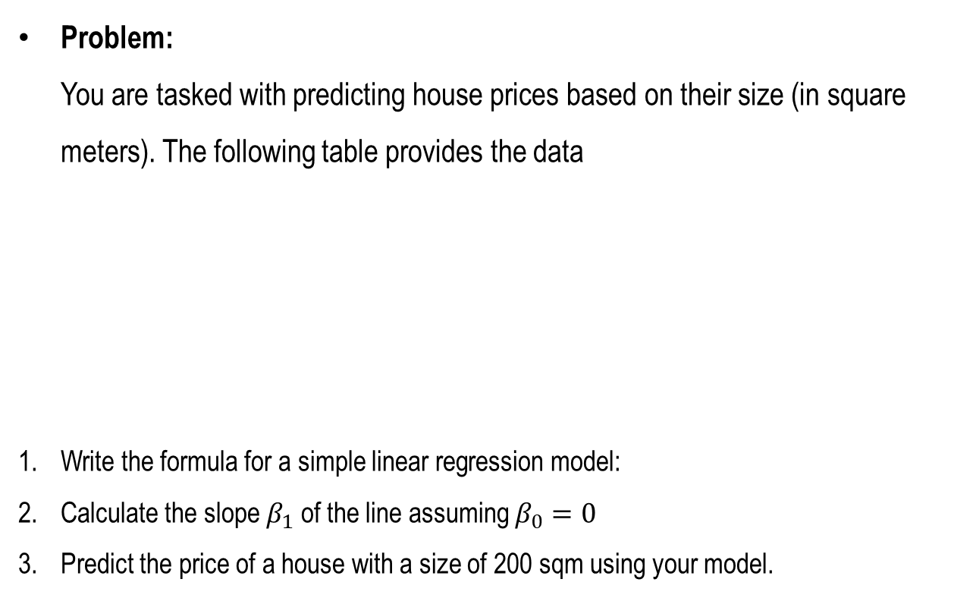
Linear Regression - Predicting House Prices
Problem: You are tasked with predicting house prices based on their size (in square meters). The following table provides the data
Write the formula for a simple linear regression model:
Calculate the slope $β_{1}$ of the line assuming $β_{0}=0$
Predict the price of a house with a size of 200 sqm using your model.
Size (sqm) | Price (in $1000s)
50 | 150
100 | 300
150 | 450

Slide 57
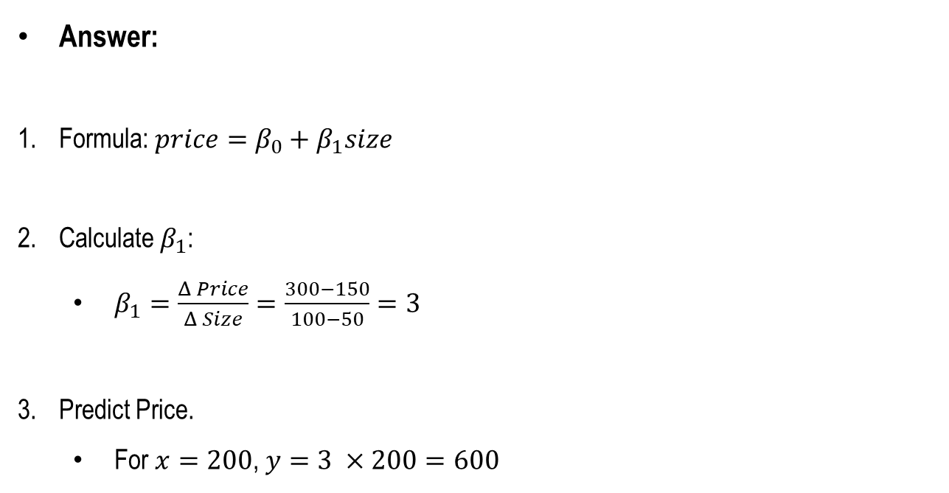
Linear Regression - Predicting House Prices
Answer:
Formula: $price=β_{0}+β_{1}size$
Calculate $β_{1}$:
$β_{1}=\frac{Δ Price}{Δ Size}=\frac{300−150}{100−50}=3$
Predict Price.
For $x=200$, $y=3 ×200=600$

Slide 58
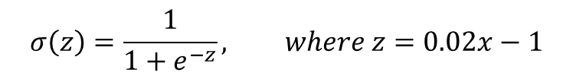
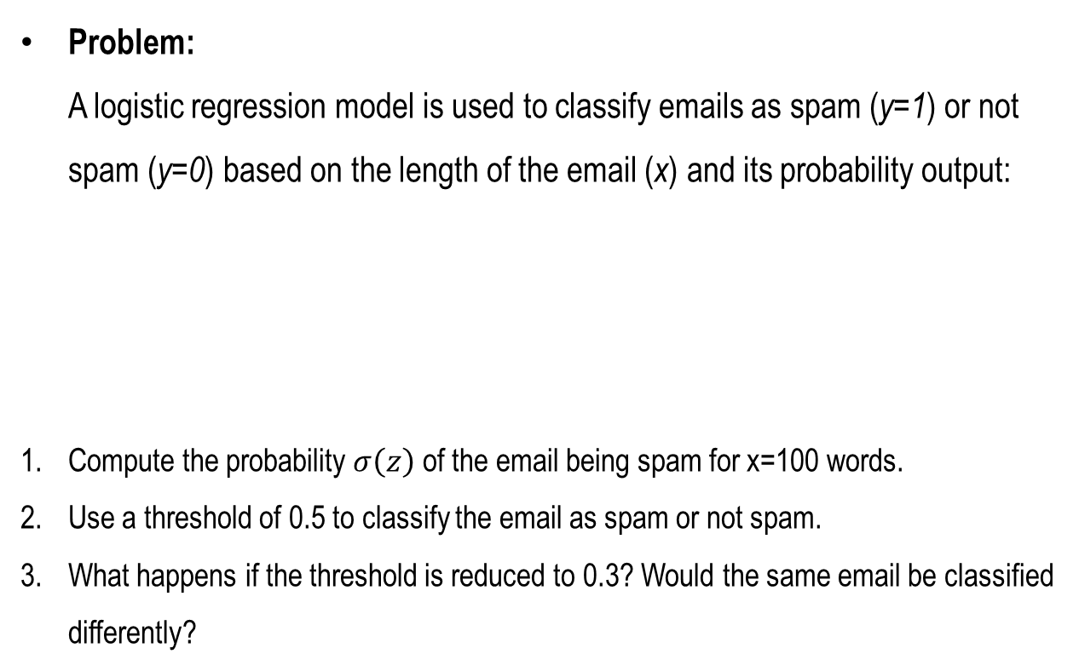
Logistic Regression - Spam Email Detection
Problem: A logistic regression model is used to classify emails as spam (y=1) or not spam (y=0) based on the length of the email (x) and its probability output:
Compute the probability $σ\left(z\right)$ of the email being spam for x=100 words.
Use a threshold of 0.5 to classify the email as spam or not spam.
What happens if the threshold is reduced to 0.3? Would the same email be classified differently?
x | exp(x) | 1/exp(x)
-2.00 | 0.14 | 7.39
-1.00 | 0.37 | 2.72
0.00 | 1.00 | 1.00
1.00 | 2.72 | 0.37
2.00 | 7.39 | 0.14
$$σ\left(z\right)=\frac{1}{1+e^{−z}}, where z=0.02x−1$$

Slide 59
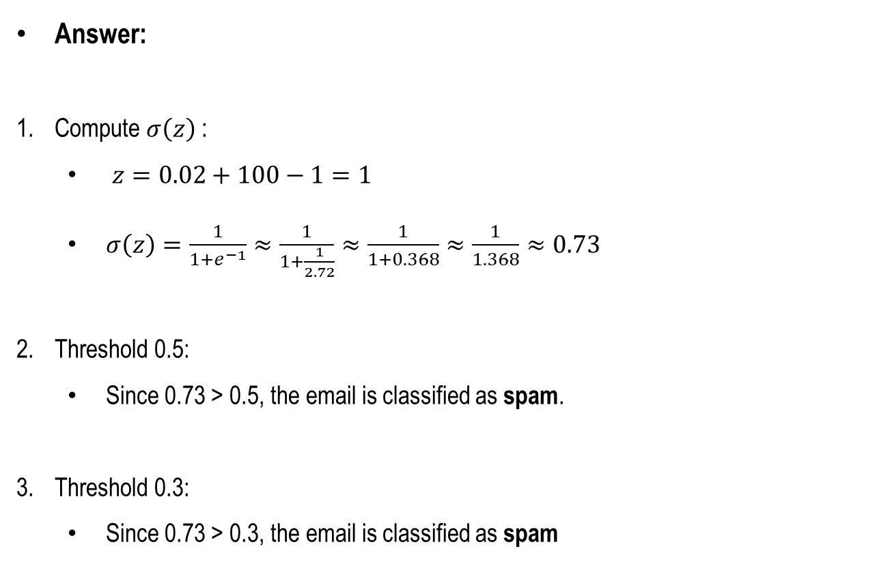
Logistic Regression - Spam Email Detection
Answer:
Compute $σ\left(z\right)$ :
$z=0.02+100−1=1$
$σ\left(z\right)=\frac{1}{1+e^{−1}}≈\frac{1}{1+\frac{1}{2.72}}≈\frac{1}{1+0.368}≈\frac{1}{1.368}≈0.73$
Threshold 0.5:
Since 0.73 > 0.5, the email is classified as spam.
Threshold 0.3:
Since 0.73 > 0.3, the email is classified as spam
x | exp(x) | 1/exp(x)
-2.00 | 0.14 | 7.39
-1.00 | 0.37 | 2.72
0.00 | 1.00 | 1.00
1.00 | 2.72 | 0.37
2.00 | 7.39 | 0.14

Slide 60
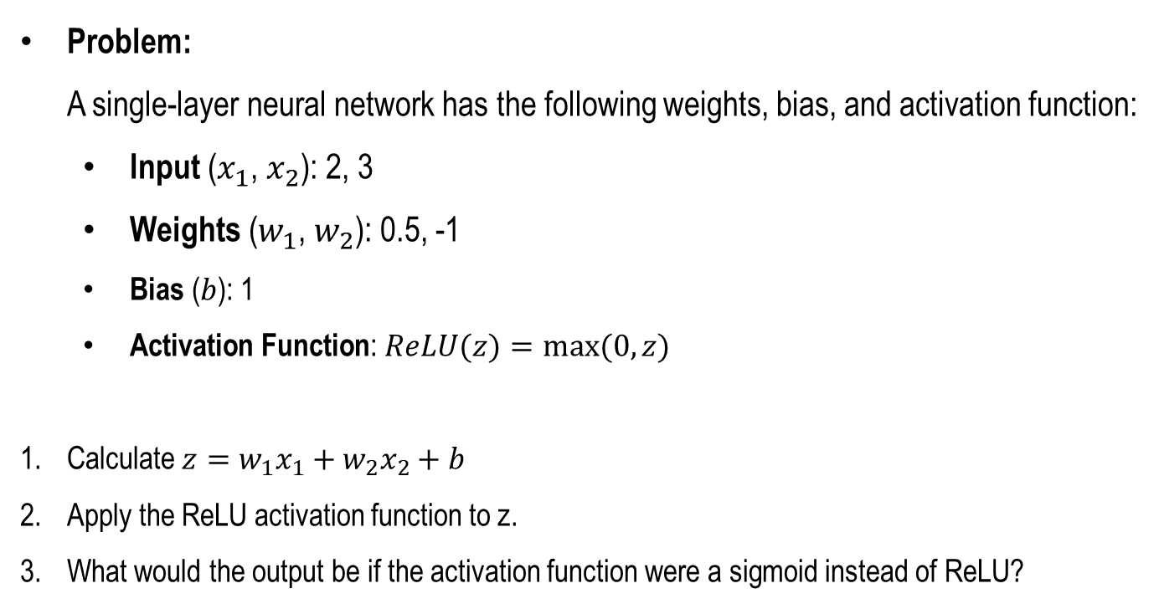
Neural Networks - Forward Propagation
Problem: A single-layer neural network has the following weights, bias, and activation function:
Input ($x_{1}$, $x_{2}$): 2, 3
Weights ($w_{1}$, $w_{2}$): 0.5, -1
Bias ($b$): 1
Activation Function: $ReLU(z)=max⁡(0,z)$
Calculate $z=w_{1}x_{1}+w_{2}x_{2}+b$
Apply the ReLU activation function to z.
What would the output be if the activation function were a sigmoid instead of ReLU?
x | exp(x) | 1/exp(x)
-2.00 | 0.14 | 7.39
-1.00 | 0.37 | 2.72
0.00 | 1.00 | 1.00
1.00 | 2.72 | 0.37
2.00 | 7.39 | 0.14

Slide 61

Neural Networks - Forward Propagation
Answer:
Calculate $z$ :
$z=\left(0.5×2\right)+\left(−1×3\right)+1=1−3+1=−1$
ReLU Activation:
$ReLU\left(−1\right)=\max\left(0,−1\right)=0$.
Sigmoid Activation:
$σ\left(−1\right)=\frac{1}{1+e^{−z}}≈\frac{1}{1+e^{z}}≈\frac{1}{1+2.72}≈0.27$
x | exp(x) | 1/exp(x)
-2.00 | 0.14 | 7.39
-1.00 | 0.37 | 2.72
0.00 | 1.00 | 1.00
1.00 | 2.72 | 0.37
2.00 | 7.39 | 0.14

Slide 62

Regularization - L1 and L2 Comparison
Problem: Consider the following weights in a neural network: [3,−4,0.5,0]. Regularization terms are calculated as follows:
$$L1 Loss=λ\sum{\left|w_{i}\right|}$$
$$L2 Loss=λ\sum{{\left(w^{i}\right)}^{2}}$$
Compute the L1 regularization term for $λ$=0.1.
Compute the L2 regularization term for $λ$=0.1.
Which regularization method reduces the weights more aggressively?

Slide 63

Regularization - L1 and L2 Comparison
Answer:
L1 Regularization:
$λ\sum{\left|w_{i}\right|}=0.1×\left(\left|3\right|+\left|−4\right|+\left|0.5\right|+\left|0\right|\right)=0.1×7.5=0.75$
L2 Regularization:
$λ\sum{{\left(w^{i}\right)}^{2}}=0.1×\left(3^{2}+{(−4)}^{2}+{0.5}^{2}+0^{2}\right)$
$$=0.1×\left(9+16+0.25\right)=0.1×25.25=2.525$$
Conclusion:
L1 regularization is more aggressive in reducing weights to zero, promoting sparsity, whereas L2 regularization smooths weight distributions.

